Slide 1
Construction Technology Development in Korea - Case Study -
Cho, Jung-Keun
Korea Institute of Civil Engineering and Building Technology

Slide 2
Contents
Ⅰ. Introduction
Ⅱ. Overview of Construction Industry Development in Korea
Ⅲ. Construction Technology Introduction Stage
Ⅳ. Construction Technology Chase Stage
Ⅴ. Post-Technical Chase and Leading Technology Stage
Ⅵ. What about Other Countries?
Ⅶ. Concluding Remarks

Slide 3

Ⅰ. Introduction
What keywords come to mind when you think of “Korea”?
BTS
Black Pink
K-Pop
K-Content
Parasite
Samsung LG Hyundai
New Village Movement
IT
Mobile Home Appliances Car
ITS BIS
Transportation Card System
Ppalli-Ppalli(quickly & quickly)
BIM, Free Wi-Fi
Wide Tunnel Long Bridge
Smart City
Korean War
Divided Country
Small Reactor Technology
Starvation
Least Developed Countries
Ultra-high-rise Building

Slide 4
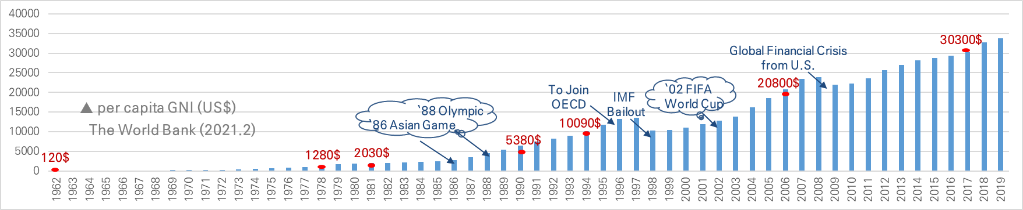
Ⅰ. Introduction
Construction Industry and Economic Development in Korea
Korea, One of the World`s Least Developed Countries (LDC) about 70 years ago
Became a new sovereign state in 1945 but divided into South and North
The Korean War(1950.06~1953.07): All industries were ruined and depended on foreign aid
About 60 years ago, in Korea, per capita GNI was less than USD 100$, and many people were suffering from hunger
Rapid Industrialization since the 1960s
The industrialization has begun since 1961, characterized by the “Ppalli Ppalli (quickly & quickly)" and the "New Village Movement"
Driving Force: People (education and diligence) + Technocrat (passion and leadership)
It took about 35 years to be a member of OECD (1996)
■ Changes in per capita GNI (Gross National Income) after Korea’s industrialization

Slide 5
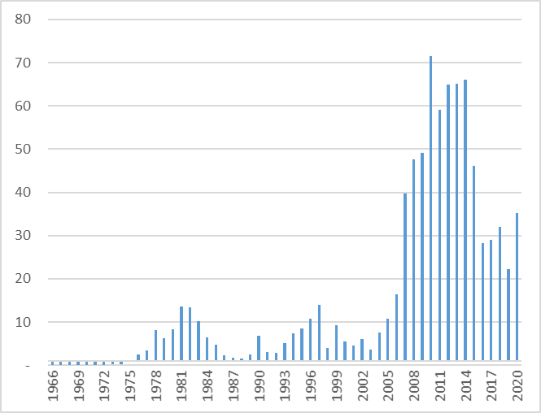
Ⅰ. Introduction
Construction Industry and Economic Development in Korea
Construction Industry as a Key Contributor to Korean Industrialization
Korea had invested extensively in various infrastructure with the start of industrialization
Roads, railways, airports, ports, electricity, steel, etc.
Gyeong-Bu Expressway (`68.2.1 ~ `70.7.7): Seoul-Busan 416.05km, by Korean own technology
Construction has been a key sector for national economy during industrialization
In 70s-80s, construction industry grew rapidly with expansion of the Middle-East market,
Construction industry’s contribution to national economy reached to 21% of GNP in `90s
Construction Investment (USD, Million]
Value of Orders (USD, Billion)
Percentage of GDP (%)
▲ Value of Overseas Construction Contracts
▲ Construction Investment & Percentage of GDP

Slide 6
Ⅱ. Overview of Construction Industry Development in Korea
Definition of Construction Technology
It shall contribute to the promotion of public welfare and the development of the national economy by carrying out the proper implementation of construction works, and ensuring the quality and safety of construction works
Classification of construction technology to secure the appropriateness of construction work (construction cost, construction period, formativeness, environmental characteristics, etc.)
Construction project management technology: construction market research and discovery, finance, purchasing and procurement, bidding, etc.
Construction engineering technology: planning, survey, design, testing, evaluation, supervision, natural disaster prevention, formative security and environmental protection technology, etc.
Construction work technology: planning, manufacturing, transportation, installation, on-site construction technology, etc.
Operation and maintenance technology: operation, safety inspection, maintenance, etc.
※ Definition of construction technology based on Korea’s Construction Technology Promotion Act

Slide 7
Ⅱ. Overview of Construction Industry Development in Korea
Development (Chasing) Stage of Construction Technology
Development (chasing) stage of general technology
Technological development in developing countries generally follows the path of developed countries
Frog jumping phenomenon of technology occurs according to industry characteristics
The phenomenon of going from stage A to stage C or D without going through stage B
This phenomenon occurs most frequently in the ICT field
As the most representative case enters the wireless communication stage without going through the wired communication stage, various frog jumping phenomena occur
China's mobile payment technology is a representative example of the frog jumping phenomenon and is the world's best: Alipay, etc.
Step A → Step B → Step C → Step D
Technology Introduction → Technology Chase →
Post-Technology Chase → Technology Leading

Slide 8
Ⅱ. Overview of Construction Industry Development in Korea
Development (Chasing) Stage of Construction Technology
Characteristics of construction technology
Frog jumping phenomenon rarely occurs in construction technology
It means that certain fields of construction technology in which the phenomenon of frog jumping occurs are subordinated to foreign technology
Therefore, in the case of construction technology, it generally follows the path of developed countries
Construction technology should achieve mutual development with related industries
Development of materials, products, and equipment industries related to construction
Plant industry (cement, steel, glass, waste, etc.) power generation
Construction technology must ensure the quality and safety of construction work
It must meet the requirements of construction-related laws and system set forth in this
After the collapse of Seongsu Bridge in 1994, the construction technology management system in various fields was established focusing on construction technology

Slide 9
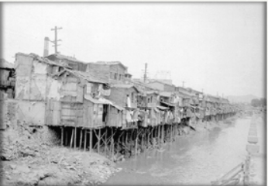
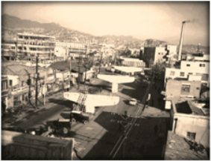
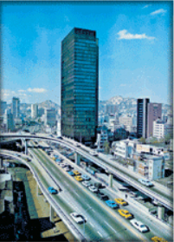

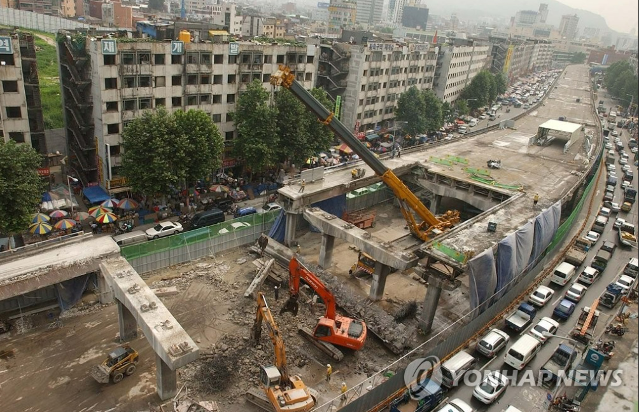
Ⅱ. Overview of Construction Industry Development in Korea
Cheonggyecheon Stream Change Process
Representative examples of the transition process of the construction industry and construction technology in Korea
Cheonggyecheon in 1960’s
Cover up stream with concrete (1958~1977)
Elevated highway (1967~1971)
Cheonggyecheon in 2021
Restoration (2003~2005)

Slide 10
Ⅲ. Construction Technology Introduction Stage
Construction Technology Introduction Stage (1962~1982)
The period when per capita GNI went from $120 to $2,000
The construction industry plays a leading role in national economic development by expanding various construction infrastructure.
Construction technology introduction and learning stage (1962~1971)
Ministry of Construction (MOC) established government organization in 1962
Introduction and learning of construction technology from foreign engineers in the process of supporting the five-year economic development plan
1st Five-Year Economic Development Plan (1962-1966)
Full-scale construction of infrastructures such as roads, railroads, electric power plant, etc.
Learning while observing the detailed design and specification of infrastructure facilities by foreign engineers
Completion of Yanghwa Bridge, Seomjin River multi-purpose dam, etc.
The development stage of construction technology in Korea can be classified differently according to scholars, and the development stage defined here was based on my opinion and experience

Slide 11
Ⅲ. Construction Technology Introduction Stage
Construction Technology Introduction Stage (1962~1982)
Construction technology introduction and learning stage (1962~1971)
The 2nd Five-Year Economic Development Plan (1967~1971)
Expansion of transportation infrastructure such as highways and ports, reinforcement of water resource management, etc.
Completion of Gyeongin Expressway, Gyeongbu Expressway, Namgang Multipurpose Dam, etc.
Started construction of Pohang Steel (POSCO), Ulsan Petrochemical Complex, Soyang River Dam, etc.
Construction technology introduction and imitation stage (1972~1982)
The 1st 10-Year Comprehensive National Land Development Plan (1972~1981)
Same as the 3rd and 4th Five-Year Economic Development Plan period
The emergence of engineering companies following the creation of large-scale industrial complexes
Established the foundation for company establishment with the enactment of the Technical Service Promotion Act in 1973
Construction technology development started with the emergence of construction engineering companies

Slide 12
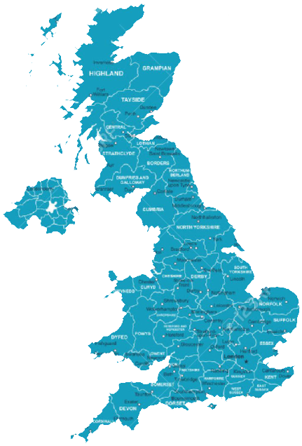
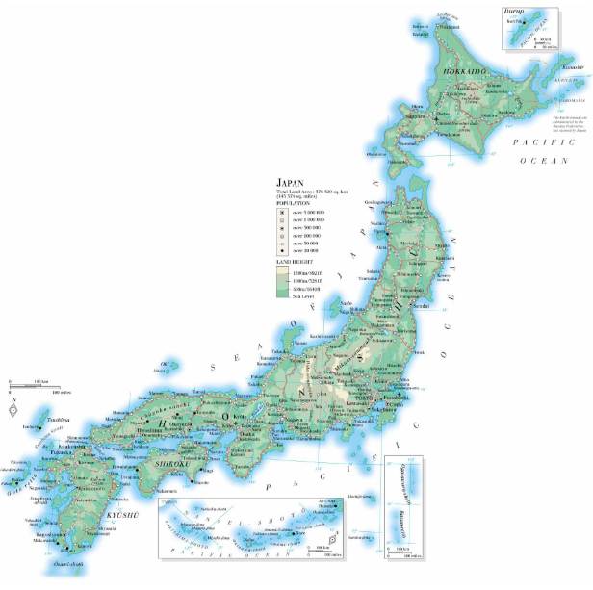
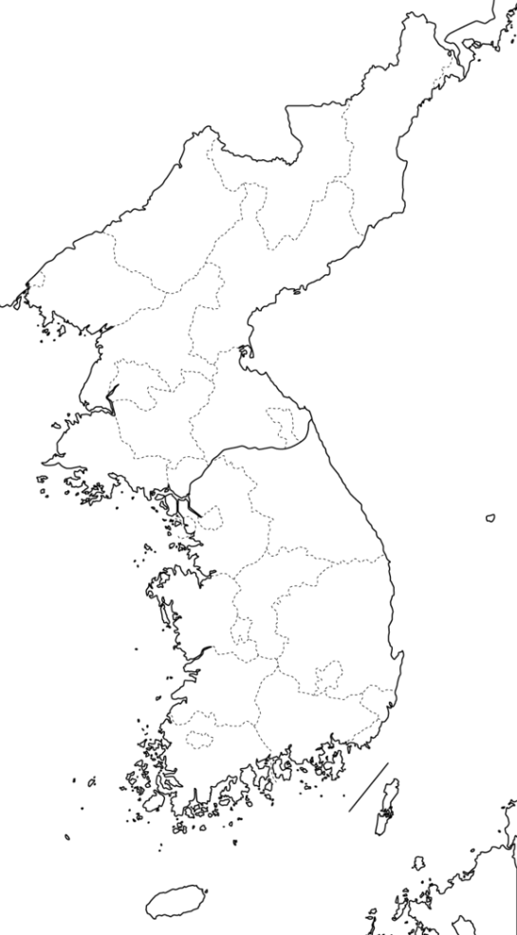
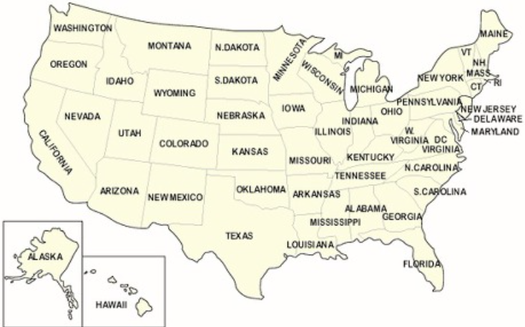
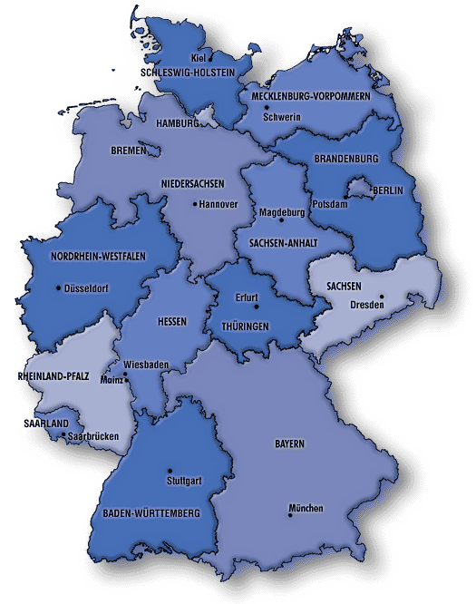
Ⅲ. Construction Technology Introduction Stage
Korea Building Code Introduction Stage (1962~1982)
Initial introduction of Building Codes in Korea
Establishment of Building Code system started in the 1960s, when industrialization began
1962: MOC launched, Building Act enacted, Korea Construction Research Institute launched, Industrial Standardization Act, which is the basis of Korea Industrial Standards (KS), enforced
This period is mainly a copy of Japanese Building Code
Reflecting some of the lessons learned in the detailed design and specification writing process of foreign engineers for infrastructure facilities
Countries that influenced the establishment of Korea Building Code system
England
Colonial Rule
(early 20C)
Germany
Industrialization
(60s~70s)
Industrialization
(80s~)
Japan
Korea
U.S.A

Slide 13
Ⅳ. Construction Technology Chase Stage
Construction Technology Chase Stage (1983~1994)
When per capita GNI enters the $10,000 range from the $2,000 range
Transition from people-oriented construction to technology-oriented construction
Chasing construction technology and creating a foundation for technological independence
The 2nd 10-Year Comprehensive National Land Development Plan (1982~1991)
Per capita GNI increased from $2,000 to $7,000
Hosting the 1986 Asian Games and the 1988 Olympic Games, improving the living environment of the people
Announcement and commencement of development of new towns such as Bundang, Ilsan, etc.
Entering the era of full-scale construction technology development with the establishment of the KICT (Korea Institute of Civil Engineering and Building Technology) (1983.06)
Time to overcome the foreign exchange crisis by entering the Middle East construction industry in the early 1980s
Enactment of Construction Technology Management Act entered into force (Jan. 1988)
The law was enacted in the wake of the fire incident at the Independence Hall in 1986.
Establishing a support system and expanding the budget for the government's R&D of construction technology

Slide 14
Ⅳ. Construction Technology Chase Stage
Construction Technology Chase Stage (1983~1994)
Moving from quantitative growth to qualitative growth
Expansion of technology development investment by construction companies
10-20% annual technology investment budget increase since 1985
Increase in establishment of research departments and technology research centers by company
Large construction companies prepare for the Uruguay round: Pursue EC (Engineering Construction) and promote competitiveness in plant construction
The government is interested in solving social problems such as maintenance of living environment facilities such as housing and water and sewerage in economic development centered on growth
Expansion of housing supply, formation of a wide-area water supply system
Expanded environmental impact assessments such as domestic sewage and industrial wastewater
The period of transition from development-oriented construction to construction that improves the quality of life such as environmental improvement
First application of cement pavement technology highway: 88 Olympic Expressway
Yeouido 63 Building (high-rise steel structure) completed: 1985

Slide 15
Ⅳ. Construction Technology Chase Stage
The Full Introduction of US Building Code
Reflecting the influence and introduction of US Building Code
Start of transition from Japan-centered Building Code to US-centered Building Code
Entering the era of construction technology development and expanding the return of Korean students studying in the USA to their home countries
Start of Local Adaptation to the Building Code suitable for the situation in Korea
Start of the revised work on Korean Building Code in preparation for the WTO
Countries that influenced the establishment of Korea Building Code system
England
Colonial Rule
(early 20C)
Germany
Industrialization
(60s~70s)
Industrialization
(80s~)
Japan
Korea
U.S.A

Slide 16
Ⅴ. Post-Technical Chase and Leading Technology Stage
Post-Technical Chase Stage in the Construction Field (1995~2005)
Between $10,000 and $18,000 per capita GNI
1995 WTO launched, Joining the OECD and IMF bailout period
Reorganization of related laws and systems due to continuous construction accidents
Continuous accidents such as the collapse of Seongsu Bridge
Collapse of Sinhaengju Bridge under construction (1992), Collapse of Seongsu Bridge (1994)
Gupo train overturned accident (1993), Collapse of Sampoong Department Store (1995)
Reinforcement of Facility Inspection and O&M
Enactment of the Special Act on Safety Control and O&M of Facilities
Establishment of KISTEC (Korea Infrastructure Safety & Technology Corporation)
Development of Safety Diagnosis and Maintenance Manual for 13 types of facilities
Time to overcome difficulties caused by the launch of the WTO and the IMF
With the launch of the WTO, construction technology entered a free competition system
Reorganization of the Korean construction industry due to the subsequent IMF
Korea, which focuses on construction work technology, has experienced a period of decline in the overseas construction market

Slide 17
Ⅴ. Post-Technical Chase and Leading Technology Stage
Post-Technical Chase Stage in the Construction Field (1995~2005)
Comprehensive construction technology development stage
Equipped with a comprehensive technology development system such as ‘construction project management technology’, ‘operation and maintenance technology’, and ‘construction engineering technology’ in a technology development system centered on ‘construction work technology’
Establishment and implementation of relevant government policies and systems
Advancement of construction technology through large-scale construction
2002 KoreaㆍJapan World Cup: Design and construction technology for large space structures
Development of related complex technologies through the activation of high-rise buildings: materials and materials, facility environment and information communication, construction and maintenance, structureㆍsafetyㆍdisaster prevention, etc.
Technology related to airports, high-speed rail, and Korean nuclear power plants
Globalization of long bridge and tunnel technology
Through this, the level of Korean construction technology was upgraded

Slide 18
Ⅴ. Post-Technical Chase and Leading Technology Stage
Post-Technical Chase Stage and Leading Technology Stage (2006~Present)
When per capita GNI exceeds $20,000 to $30,000
Korea is the only country in the world that became a developed country from a low-income country
The gap between the level of construction technology with advanced countries has narrowed significantly, and Korea has begun to lead the global construction technology in certain construction technology fields.
Entering the era of infinite competition
Fierce competition in the overseas construction market due to the end of Korea's development era
Still, some technical fields such as ‘construction project management technology’ and ‘construction engineering technology’ are inferior to advanced countries
Overcoming inferior technological fields and strengthening the technological fields stronger
It is necessary to share Korea's experience and know-how with developing countries, and to establish a win-win-based strategy for mutually beneficial cooperation and mutual growth
Expanding the concept of construction engineering by winning the PMO project
Ordered PMO project for Chinchero New Airport project in Peru (2019.10)
Peru Chinchero New Airport Terminal Project Order (2021.07)

Slide 19
Ⅴ. Post-Technical Chase and Leading Technology Stage
Post-Technical Chase Stage and Leading Technology Stage (2006~Present)
Entering the era of infinite competition
World-class construction technology construction work
Various bridges in Korea and Canakkale Bridge project in Turkey
Opened various wide tunnels in Korea and Eurasia tunnel in Turkey
Jamsil Lotte World Tower (123th floor building) in Korea and Burj Khalifa (163th floor building) in Dubai
In addition, leading specific technology fields such as smart city, small reactor technology, etc.
Promote R&D intensive investment in the field of future construction technology that can lead the world
Technology to cope with climate change: buildings, transportation, energy, etc.
Mobility technology: Self-driving, drone, etc.
Digital management technology: Digital twin, BIM, etc.
Smart City Technology: Convergence of various technologies
Establishing a roadmap for MOLIT ODA projects and strengthening cooperation with developing countries
Linked with Korea-supported Grant Aid projects, PPP projects, EPC projects, etc.

Slide 20
Ⅴ. Post-Technical Chase and Leading Technology Stage
Development and Operation of Korea Building Code (1995~Present)
Full-scale development of Korea Building Code
Response to the launch of the WTO and the collapse of various facilities in the 1990s
Thorough local adaptation to Building Code introduced and adopted in foreign countries
Compensation and new enactment for insufficient Building Code
Establishment of the Construction Standards Maintenance Council under the MOLIT
The vice president of KICT is the chairman, and KICT oversees the revision of Korea Building Code
2013 KCSC (Korea Construction Standards Center) launched
Need for Reorganizing Separate Construction Standards Management System
Confusion in the construction field due to different terms and standards
Need to reflect the results of various empirical tests to prevent poor construction quality
Need to improve the performance, save costs, and reflect newest technology
Establishment of Korea Building Code: Integrate and unify detailed technical regulations described for each facility, and convert to a Building Code Platform form that uses detailed technical regulations for each facility

Slide 21
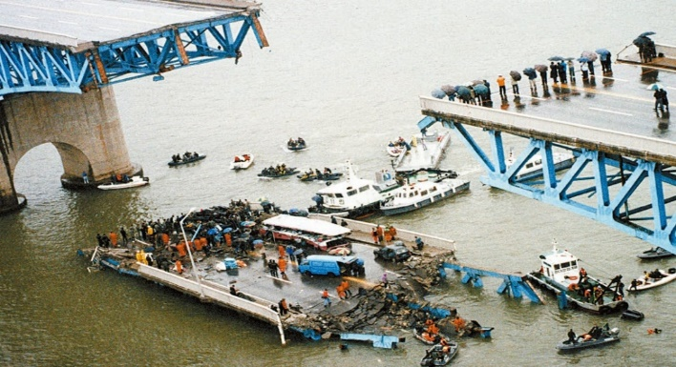
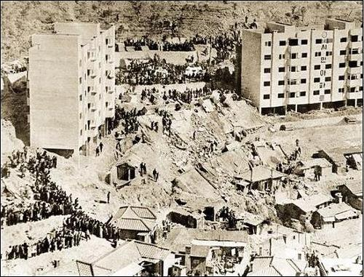
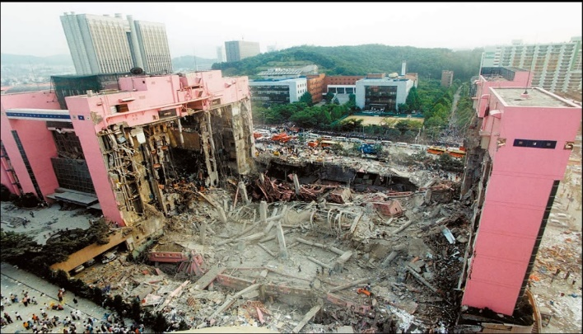
Ⅵ. What about Other Countries?
Large-Scale Facility Collapse Accidents in Korea in the Past
WOW Apartment Collapse/
Seoul (1970.4.8)
Details : Collapse of the 5F Apartment
Damage of Life : 33 deaths, 39 injuries
Seongsu Bridge Collapse/
Seoul (1994.10.21)
Details :
48M Fall on the Center of the Bridge, 6 of bus/car crashed
Damage of Life :
32 deaths, 17 injuries
Sampoong Department Store Collapse/
Seoul (1995.6.29)
Details :
complete collapse of the department both complex
Damage of Life :
502 deaths, 937 injuries

Slide 22
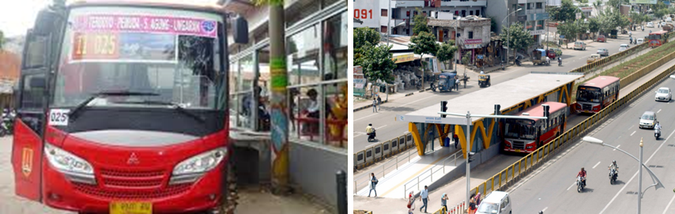
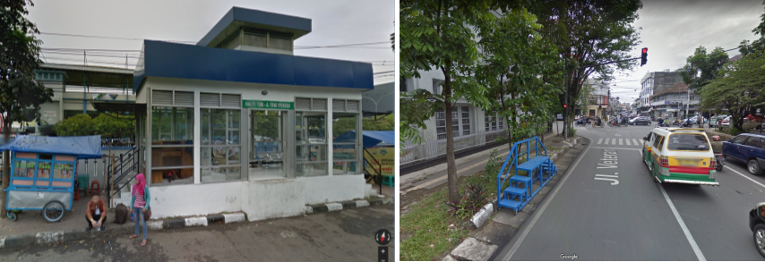
Ⅵ. What about Other Countries?
Example of Building Code that Failed to Locally Adaptation
Example of BRT in Indonesia
Jakarta
Jakarta City installed and operated BRT by introducing foreign building code
Contributing to relieving traffic congestion through normal operation
Bandung city applies foreign building code without considering poor road conditions
Advice on the possibility of problems arising from the Korean supervisory company was not accepted
It loses its function as a BRT and causes a lot of inconvenience to citizens using the bus
Bandung

Slide 23
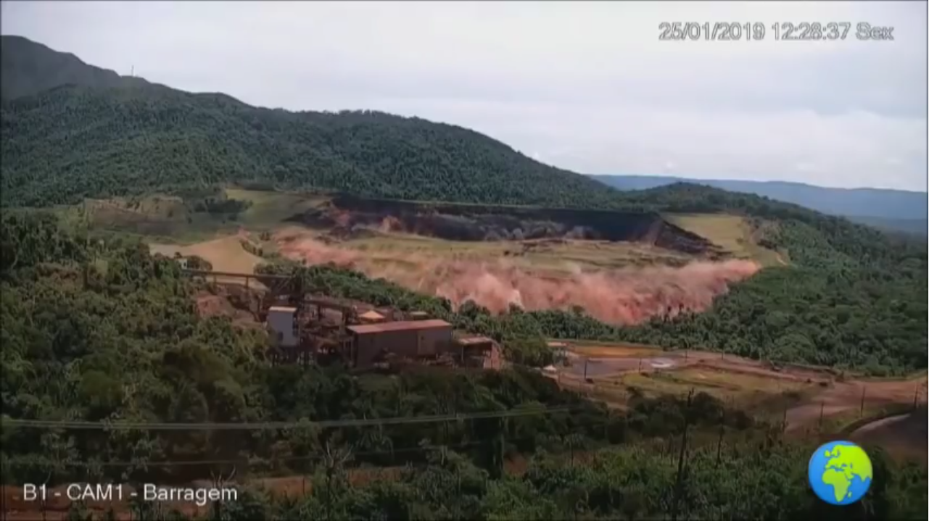
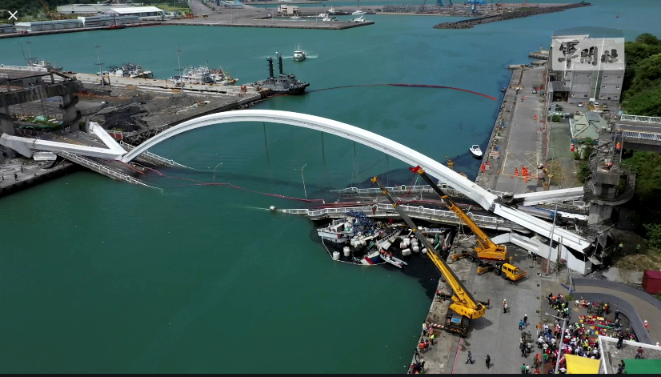
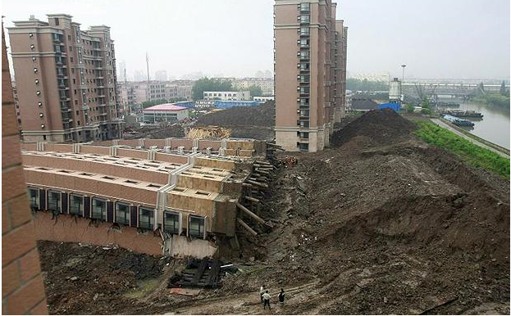
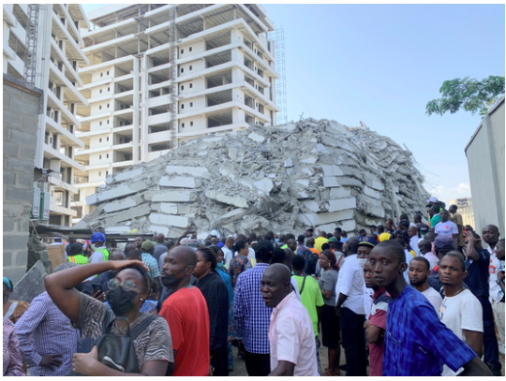
Ⅵ. What about Other Countries?
The collapse continues today
Brumadinho dam disaster, Brazil (Jan 25, 2019)
Bridge Collapse in Taiwan (Oct 1, 2019)
Building Collapse in Shanghai, China (May 16, 2019)
21-Story Building Collapses in Lagos, Nigeria (Nov 1, 2021)

Slide 24
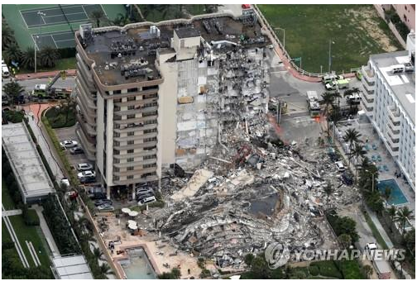
Ⅵ. What about Other Countries?
The collapse continues today
Apartment Building Collapses in Florida, USA (June 24, 2021)
Even the United States, the world's richest and most technologically advanced country, cannot avoid construction accidents
Excessive cost expected due to obsolescence of facilities
ASCE expects to spend USD 4.59 trillion to improve all construction infrastructure in the U.S. according to U.S. Building Code (2016-2025, as of 10 years)
Building code for facilities are important, but O&M of built facilities are also important

Slide 25
Ⅶ. Concluding Remarks
Concluding Remarks
We are faced with the challenge of which Building Code to choose
Which Building Code is the best case or the optimized case?
Through this thinking, Uzbekistan should find a way to modernize UBC
Korea's case will be helpful to find the way

